Slide 1

Classification MEthods
Chapter 04 (part 01)
Notes:
The linear regression model discussed in Chapter 3 assumes that the response variable Y is quantitative. But in many situations, the response variable is qualitative. If we were hired by a firm, For example, to investigate inventory shrinkage; the possibilities aren’t endless. sources of inventory shrinkage is qualitative, taking finite values like values employee theft, shoplifting, administrative error, and vendor fraud. Often qualitative variables are referred to as categorical; we will use these terms interchangeably.

Slide 2
Outline
Cases:
Orange Juice Brand Preference
Credit Card Default Data
Why Not Linear Regression?
Simple Logistic Regression
Logistic Function
Interpreting the coefficients
Making Predictions
Adding Qualitative Predictors
Multiple Logistic Regression
Notes:
In this lecture, we study approaches for predicting qualitative responses, a process that is known as classification. Predicting a qualitative response for an observation can be referred to as classifying that observation, since it involves assigning the observation to a category, or class. On the other hand, the methods used for classification often predict the probability of each of the categories of a qualitative variable, as the basis for making the classification. In this sense they also behave like regression methods. There are many possible classification techniques. In this video we discuss three of the most widely-used classifiers: logistic regression, linear discriminant analysis, and K-nearest neighbors. We discuss more computer-intensive methods in later chapters, such as generalized additive models (Chapter 7), trees, random forests, and boosting (Chapter 8), and support vector machines (Chapter 9).

Slide 3
Case 1: Brand Preference for Orange Juice
We would like to predict what customers prefer to buy: Citrus Hill or Minute Maid orange juice?
The Y (Purchase) variable is categorical: 0 or 1
The X (LoyalCH) variable is a numerical value (between 0 and 1) which specifies the how much the customers are loyal to the Citrus Hill (CH) orange juice
Can we use Linear Regression when Y is categorical?
Notes:
Just as in the regression setting, in the classification setting we have a set of training observations (x1, y1),...,(xn, yn) that we can use to build a classifier. We want our classifier to perform well not only on the training data, but also on test observations that were not used to train the classifier.
Classification problems occur often, perhaps even more so than regression problems. We’ll learn these techniques using two examples, the first of which is a brand preference question.
A customer arrives to a store to purchase orange juice and either purchased Citrus Hill or Minute Maid Orange Juice. We’d like to understand what factors lead to their preference for a particular brand?
We are interested in predicting whether an individual will default on his or her credit card payment, on the basis of annual income and monthly credit card balance.
A person arrives at the emergency room with a set of symptoms that could possibly be attributed to one of three medical conditions. Which of the three conditions does the individual have?
An online banking service must be able to determine whether or not a transaction being performed on the site is fraudulent, on the basis of the user’s IP address, past transaction history, and so forth.

Slide 4
Why not Linear Regression?
When Y only takes on values of 0 and 1, why standard linear regression in inappropriate?
0.9
How do we interpret values greater than 1?
0.7
Purchase
0.5
0.4
0.2
How do we interpret values of Y between 0 and 1?
0.0
.0
.1
.2
.3
.4
.5
.6
.7
.8
.9
1.0
LoyalCH
Notes:
So Linear regression is not appropriate in the cases with a qualitative response. Now, Suppose that we are trying to predict the sources of inventory shrinkage. In this simplified example, there are four possible causes: employee theft, shoplifting, administrative error, and vendor fraud. We could consider encoding these values as a quantitative response variable, Y , as follows: Y={1,2,3,4}
Using this coding, least squares could be used to fit a linear regression model to predict Y on the basis of a set of predictors X1,...,Xp. Unfortunately, this coding implies an ordering on the outcomes, putting administrative error in between shoplifting and vendor fraud, and insisting that the difference between shoplifting and administrative error is the same as the difference between administrative error and vendor fraud. In practice there is no particular reason that this needs to be the case. For instance, one could choose an equally reasonable coding, y={1= vendor fraud; 2= administrative error; 3=employee theft; 4= shoplifting}
which would imply a totally different relationship among the four conditions. Each of these codings would produce fundamentally different linear models that would ultimately lead to different sets of predictions on test observations.
Even If the response variable’s values did take on a natural ordering, such as mild, moderate, and severe, and we felt the gap between mild and moderate was similar to the gap between moderate and severe, then a 1, 2, 3 coding would be reasonable. Unfortunately, in general there is no natural way to convert a qualitative response variable with more than two levels into a quantitative response that is ready for linear regression.
For a binary (two level) qualitative response like our OJ example, the situation is better. For binary instance, there are only two possibilities: Citrus Hill or Minute Maid Orange Juice. We could then potentially use the dummy variable approach from Section 3.3.1 to code the response as follows: Y = 0 if Minute Maid; 1 if Citrus Hill. We could then fit a linear regression to this binary response, and predict Citrus Hill brand preference if Yˆ > 0.5 and Minute Maid otherwise. In the binary case it is not hard to show that even if we flip the above coding, linear regression will produce the same final predictions.

Slide 5
Problems
The regression line β₀+β₁X can take on any value between negative and positive infinity
In the orange juice classification problem, Y can only take on two possible values: 0 or 1.
Therefore the regression line almost always predicts the wrong value for Y in classification problems
Notes:
For a binary response with a 0/1 coding as above, regression by least squares could make sense; it can be shown that the Xβˆ obtained using linear regression is in fact an estimate of Pr(Citrus Hill |X) in this special case. However, if we use linear regression, some of our estimates might be outside the [0, 1] interval (like you see in the Figure here), making them hard to interpret as probabilities!
Nevertheless, the predictions provide an ordering and can be interpreted as crude probability estimates. Curiously, it turns out that the classifications that we get if we use linear regression to predict a binary response will be the same as for the linear discriminant analysis (LDA) procedure we’ll discuss in the next video. However, the dummy variable approach cannot be easily extended to accommodate qualitative responses with more than two levels. For these reasons, it is preferable to use a classification method that is truly suited for qualitative response values, such as the ones presented next.

Slide 6
Solution: Use Logistic Function
Instead of trying to predict Y, let’s try to predict P(Y = 1), i.e., the probability a customer buys Citrus Hill (CH) juice.
Thus, we can model P(Y = 1) using a function that gives outputs between 0 and 1.
We can use the logistic function
Logistic Regression!
Notes:
To avoid this nonsensical prediction problem, we must model p(X) using a function that gives outputs between 0 and 1 for all values of X. Many functions meet this description. In logistic regression, we use the logistic function, logistic function
To fit the model, we use a method called maximum likelihood. The logistic function produces this S-shaped curve of this form, and so regardless of the value of X, we will always obtain a sensible prediction.
Now, we’ll have to be sort of careful when we interpret the coefficient for brand loyalty. Unlike linear regression where the change in our outcome variable was always contanst (out beta estimate) with a change in our explanatory variable, There is not a straight-line relationship between p(X) and X, and the rate of change in p(X) per unit change in X depends on the current value of X

Slide 7
Logistic Regression
Logistic regression is very similar to linear regression
We come up with b₀ and b₁ to estimate β₀ and β₁.
We have similar problems and questions as in linear regression
e.g. Is β₁ equal to 0? How sure are we about our guesses for β₀ and β₁?
1
MM
0.75
P(Purchase)
0.5
CH
0.25
0
.0
.2
.4
.6
.7
.9
LoyalCH
If LoyalCH is about .6 then Pr(CH) ≈ .7.
Notes:
The Figure illustrates the fit of the logistic regression model to the Orange Juice data against Customer brand loyalty for Citrus Hill. Notice that for low values of brand loyalty we now predict the probability of Citrus Hill as close to, but never below, zero. Likewise, for high values of brand loyalty we predict a default probability close to, but never above, one.
The coefficients β0 and β1 are unknown, and must be estimated based on the available training data. In Chapter 3, we used the least squares approach to estimate the unknown linear regression coefficients. Although we could use (non-linear) least squares to fit the model (4.4), the more general method of maximum likelihood is preferred, since it has better statistical properties. The basic intuition behind using maximum likelihood to fit a logistic regression model is like this: we seek estimates for β0 and
β1 such that the predicted probability ˆp(xi) of default for each individual, corresponds as closely as possible to the individual’s observed default status. In other words, we try to find βˆ0 and βˆ1 such that plugging these estimates into the model for p(X), yields a number close to one for all individuals who prefer citrus hill, and a number close to zero for all individuals who did not.

Slide 8
Case 2: Credit Card Default Data
We would like to be able to predict customers that are likely to default
Possible X variables are:
Annual Income
Monthly credit card balance
The Y variable (Default) is categorical: Yes or No
How do we check the relationship between Y and X?
Notes:
In our second example, we will illustrate the concept of classification using the simulated credit card Default data set. We are interested in predicting whether an individual will default on his or her credit card payment, on the basis of annual income and monthly credit card balance.

Slide 9
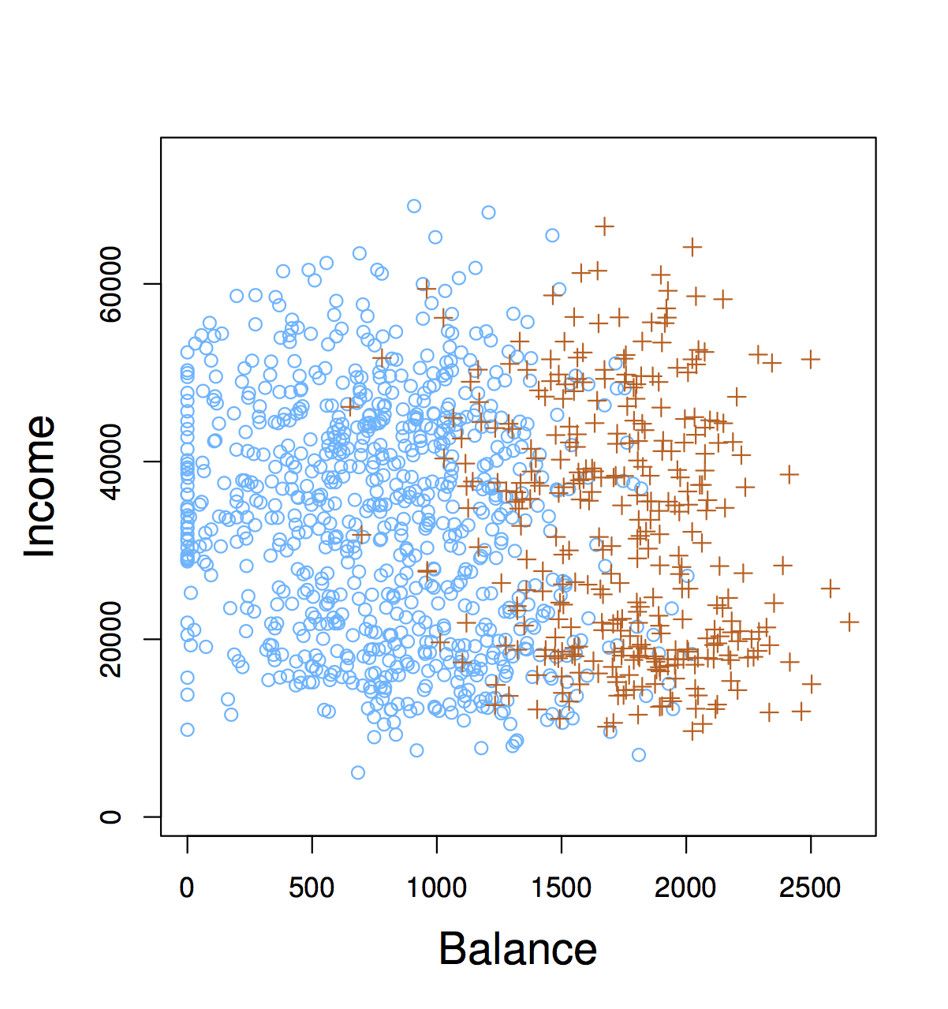
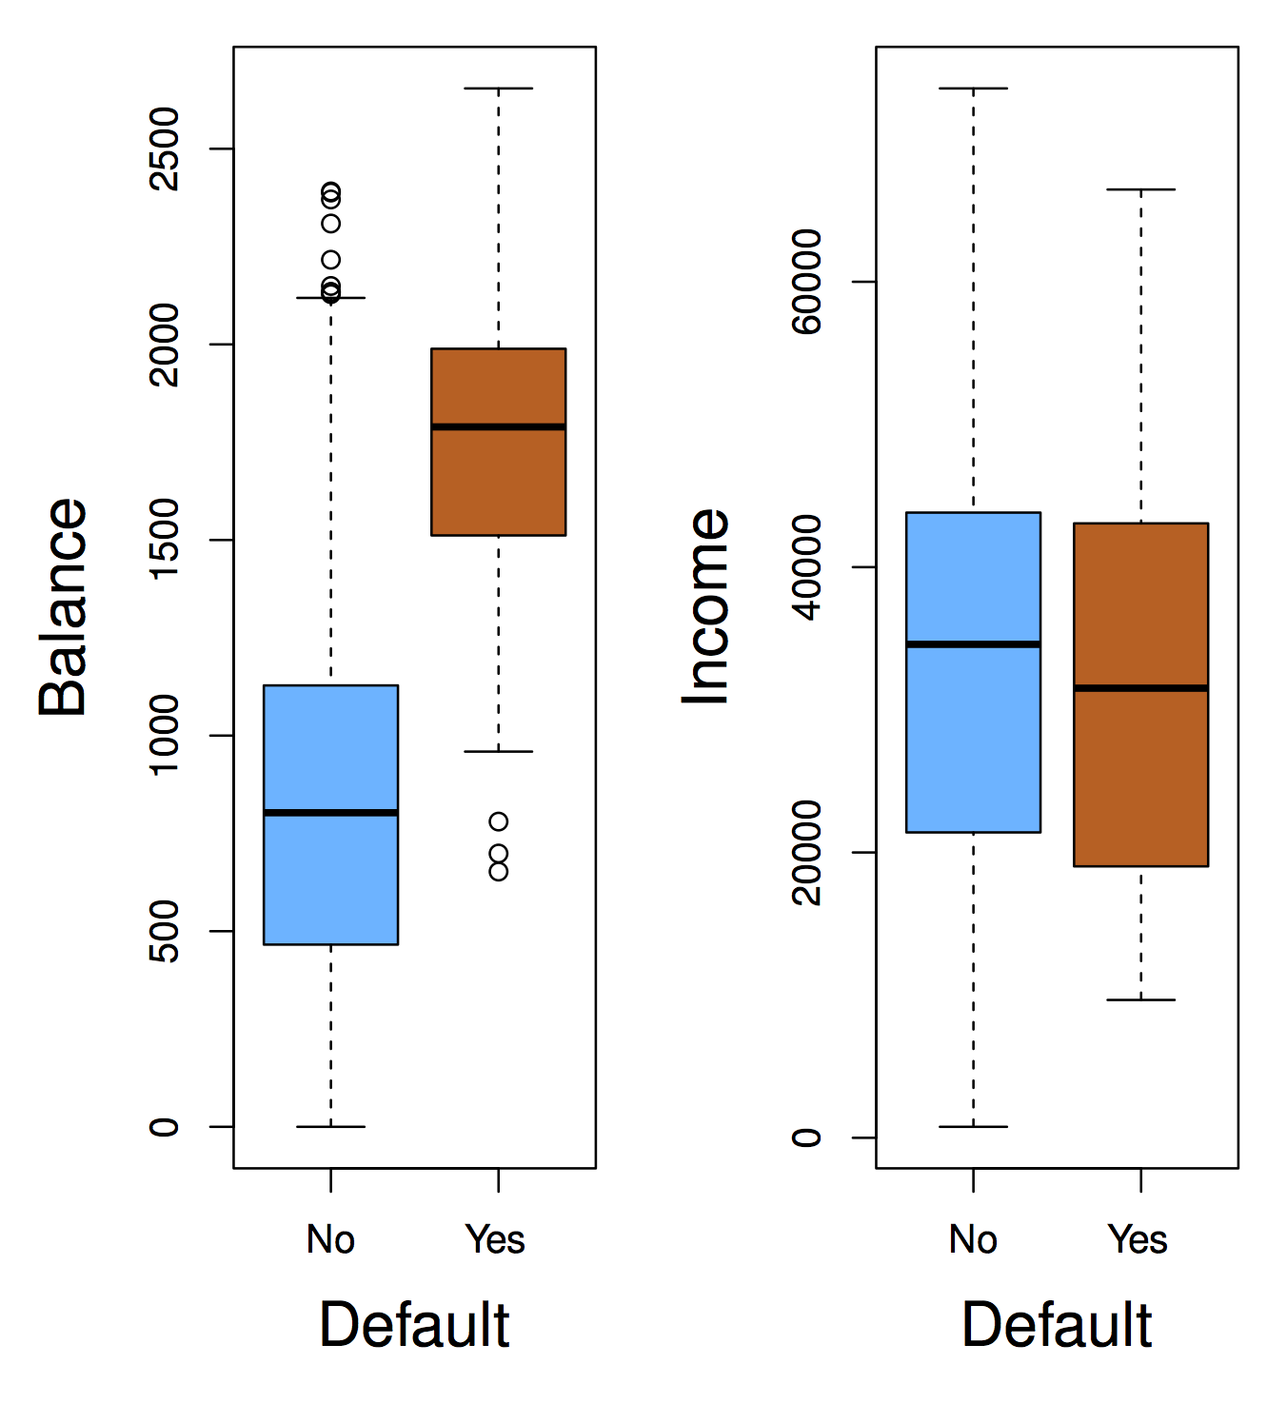
The Default Dataset
Notes:
The data set is displayed in Figure. We have plotted annual income and monthly credit card balance for a subset of 10, 000 individuals. The left-hand panel of Figure displays individuals who defaulted in a given month in orange, and those who did not in blue. (The overall default rate is about 3 %, so we have plotted only a fraction of the individuals who did not default.) It appears that individuals who defaulted tended to have higher credit card balances than those who did not. In the right-hand panel of Figure 4.1, two pairs of boxplots are shown. The first shows the distribution of balance split by the binary default variable; the second is a similar plot for income. It is worth noting that Figure 4.1 displays a very pronounced relationship between the predictor balance and the response default. In most real applications, the relationship between the predictor and the response will not be nearly so strong. However, for the sake of illustrating the classification procedures, we use an example in which the relationship between the predictor and the response is somewhat exaggerated.

Slide 10
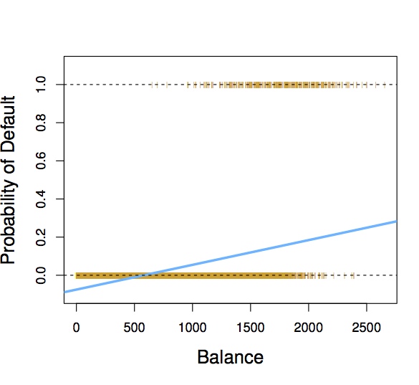
Why not Linear Regression?
If we fit a linear regression to the Default data, then for very low balances we predict a negative probability, and for high balances we predict a probability above 1!
When Balance < 500, Pr(default) is negative!
Notes:
We talked earlier about using a linear regression model to represent these probabilities: p(X) = β0 + β1X
If we use this approach to predict default=Yes using balance, then we obtain the model shown in this Figure. Here we see the problem with this approach: for balances close to zero we predict a negative probability of default; if we were to predict for very large balances, we would get values bigger than 1. These predictions are not sensible, since of course the true probability of default, regardless of credit card balance, must fall between 0 and 1. This problem is not unique to the credit default data. Any time a straight line is fit to a binary response that is coded as 0 or 1, in principle we can always predict p(X) < 0 for some values of X and p(X) > 1 for others (unless the range of X is limited).

Slide 11
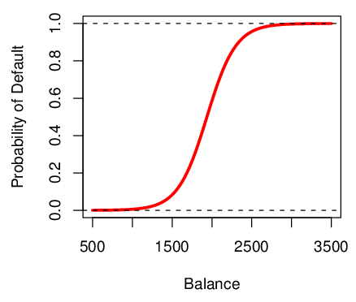
Logistic Function on Default Data
Now the probability of default is close to, but not less than zero for low balances. And close to but not above 1 for high balances
Notes:
To avoid this problem, we must model p(X) using a function that gives outputs between 0 and 1 for all values of X. We’ll apply the logistic regression model to predict default (Y ) for any given value of balance (X1) and income (X2). Again, using the logistic model that for low values of balance, we now predict the probability of default as close to, but never below, zero. Likewise, for high credit card balances we predict a default probability close to, but never above, one.

Slide 12
Interpreting β₁
Interpreting what β₁ means is not very easy with logistic regression, simply because we are predicting P(Y) and not Y.
If β₁ =0, this means that there is no relationship between Y and X.
If β₁ >0, this means that when X gets larger so does the probability that Y = 1.
If β₁ <0, this means that when X gets larger, the probability that Y = 1 gets smaller.
But how much bigger or smaller depends on where we are on the slope
Notes:
If you remember from the linear regression model, β1 gives the average change in Y associated with a one-unit increase in X. In contrast, in a logistic regression model, increasing X by one unit changes the log odds by β1, or equivalently it multiplies the odds by e^β1. However, because the relationship between p(X) and X in is not a straight line, β1 does not correspond to the change in p(X) associated with a one-unit increase in X. The amount that p(X) changes due to a one-unit change in X will depend on the current value of X. But regardless of the value of X, if β1 is positive then increasing X will be associated with increasing p(X), and if β1 is negative then increasing X will be associated with decreasing
p(X).

Slide 13

Are the coefficients significant?
We still want to perform a hypothesis test to see whether we can be sure that are β₀ and β₁ significantly different from zero.
We use a Z test instead of a T test, but of course that doesn’t change the way we interpret the p-value
Here the p-value for balance is very small, and b₁ is positive, so we are sure that if the balance increase, then the probability of default will increase as well.
Notes:
The Table shows the coefficient estimates and related information that result from fitting a logistic regression model on the Default data in order to predict the probability of default=Yes using balance. We see that βˆ1 = 0.0055; this indicates that an increase in balance is associated with an increase in the probability of default. To be precise, a one-unit increase in balance is associated with an increase in the log odds of default by 0.0055 units.
Many aspects of the logistic regression output shown in the table are similar to the linear regression output of Chapter 3. For example, we can measure the accuracy of the coefficient estimates by computing their standard errors. The z-statistic plays the same role as the t-statistic in the linear regression output, for example in Table 3.1 on page 68. For instance, the z-statistic associated with β1 is equal to βˆ1/SE(βˆ1), and so a large (absolute) value of the z-statistic indicates evidence against the null hypothesis H0 : β1 = 0. This null hypothesis implies that p(X) = eβ0 / 1+eβ0 — in other words, that the probability of default does not depend on balance. Since the p-value associated with balance in Table is tiny, we can reject H0. In other words, we conclude that there is indeed an association between balance and probability of default. The estimated intercept is typically not of interest; its main purpose is to adjust the average fitted probabilities to the proportion of ones in the data

Slide 14

Making Prediction
Suppose an individual has an average balance of $1000. What is their probability of default?
The predicted probability of default for an individual with a balance of $1000 is less than 1%.
For a balance of $2000, the probability is much higher, and equals to 0.586 (58.6%).
Notes:
Once the coefficients have been estimated, it is a simple matter to compute the probability of default for any given credit card balance. For example, using the coefficient estimates given in the Table from the previous slide, we predict that the default probability for an individual with a balance of $1, 000 is pˆ(X) = eβˆ0+βˆ1X = e−10.6513+0.0055×1,000 = 0.00576
1 + eβˆ0+βˆ1X 1 + e−10.6513+0.0055×1,000
which is below 1 %. In contrast, the predicted probability of default for an individual with a balance of $2, 000 is much higher, and equals 0.586 or 58.6 %.

Slide 15
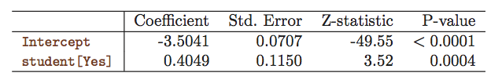
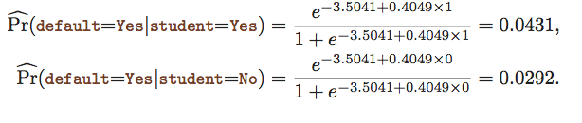
Qualitative Predictors in Logistic Regression
We can predict if an individual default by checking if she is a student or not. Thus we can use a qualitative variable “Student” coded as (Student = 1, Non-student =0).
b₁ is positive: This indicates students tend to have higher default probabilities than non-students
Notes:
One can use qualitative predictors with the logistic regression model using the dummy variable approach from Section 3.3.1. As an example, the Default data set contains the qualitative variable student. To fit the model we simply create a dummy variable that takes on a value of 1 for students and 0 for non-students. The logistic regression model that results from predicting probability of default from student status can be seen in the Table. The coefficient associated with the dummy variable is positive, and the associated p-value is statistically significant. This indicates that students tend to have higher default probabilities than non-students

Slide 16

Multiple Logistic Regression
We can fit multiple logistic just like regular regression
Notes:
We now consider the problem of predicting a binary response using multiple predictors. By analogy with the extension from simple to multiple linear regression in Chapter 3, we can generalize the equation from slide 6:
Just as in Section 4.3.2, we use the maximum likelihood method to estimate β0, β1,...,βp.

Slide 17
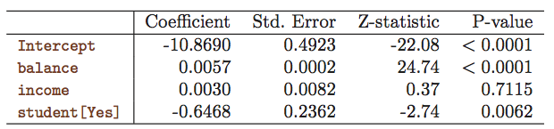
Multiple Logistic Regression- Default Data
Predict Default using:
Balance (quantitative)
Income (quantitative)
Student (qualitative)
Notes:
Table 4.3 shows the coefficient estimates for a logistic regression model that uses balance, income (in thousands of dollars), and student status to predict probability of default.
Say something about the table, interpret the coefficients

Slide 18

Predictions
A student with a credit card balance of $1,500 and an income of $40,000 has an estimated probability of default
Notes:
A student with a credit card balance of $1,500 and an income of $40,000 has an estimated probability of default

Slide 19
An Apparent Contradiction!
Positive
Negative
Notes:
The bottom table shows the coefficient estimates for a logistic regression model that uses balance, income (in thousands of dollars), and student status to predict probability of default. There is a surprising result here. The p-values associated with balance and the dummy variable for student status are very small, indicating that each of these variables is associated with the probability of default. However, the coefficient for the dummy variable is negative, indicating that students are less likely to default than nonstudents. In contrast, the coefficient for the dummy variable is positive in the table on top. How is it possible for student status to be associated with an increase in probability of default in The table on top and a decrease in probability of default in The bottom table?

Slide 20
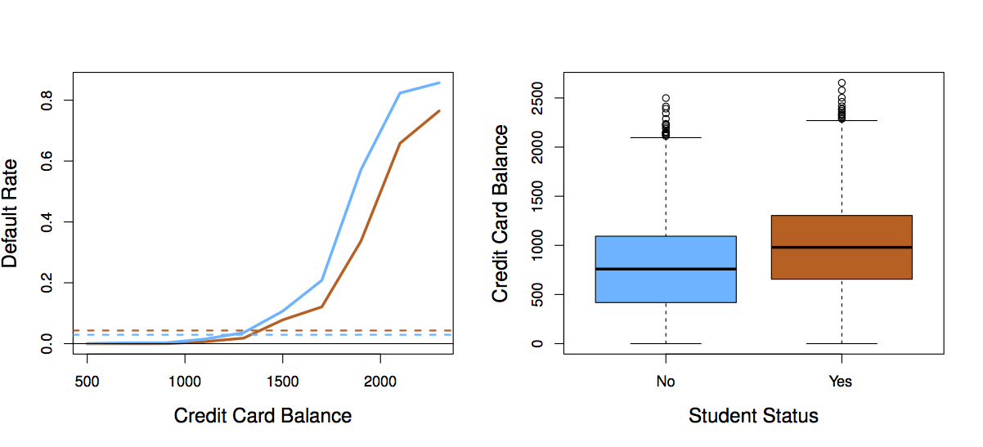
Students (Orange) vs. Non-students (Blue)
Notes:
The left-hand panel of Figure 4.3 provides a graphical illustration of this apparent paradox. The orange and blue solid lines show the average default rates for students and non-students, respectively, as a function of credit card balance. The negative coefficient for student in the multiple logistic regression indicates that for a fixed value of balance and income, a student is less likely to default than a non-student. Indeed, we observe from the left-hand panel of Figure 4.3 that the student default rate is at or below that of the non-student default rate for every value of balance. But the horizontal broken lines near the base of the plot, which show the default rates for students and non-students averaged over all values of balance and income, suggest the opposite effect: the overall student default rate is higher than the non-student default rate. Consequently, there is a positive coefficient for student in the single variable logistic regression output shown in The table on top.
The right-hand panel of Figure 4.3 provides an explanation for this discrepancy. The variables student and balance are correlated. Students tend to hold higher levels of debt, which is in turn associated with higher probability of default. In other words, students are more likely to have large credit card balances, which, as we know from the left-hand panel of Figure 4.3, tend to be associated with high default rates. Thus, even though an individual student with a given credit card balance will tend to have a lower probability of default than a non-student with the same credit card balance, the fact that students on the whole tend to have higher credit card balances means that overall, students tend to default at a higher rate than non-students. This is an important distinction for a credit card company that is trying to determine to whom they should offer credit.

Slide 21
To whom should credit be offered?
A student is risker than non students if no information about the credit card balance is available
However, that student is less risky than a non student with the same credit card balance!
Notes:
A student is riskier than a non-student if no information about the student’s credit card balance is available. However, that student is less risky than a non-student with the same credit card balance!
This simple example illustrates the dangers and subtleties associated with performing regressions involving only a single predictor when other predictors may also be relevant. As in the linear regression setting, the results obtained using one predictor may be quite different from those obtained using multiple predictors, especially when there is correlation among the predictors. In general, the phenomenon seen in Figure 4.3 is known as confounding.

